Slide 1


Prof. Mykhaylo Trubskyy
ALY 6070​ Final Project
2015 NYC Street Trees Census
By
Sunil Raj THOTA
Nalini MACHARLA
Sumadhura THANANKI
Lakshmi Priya NEELAMSETTY

Slide 2
Introduction
2015 NYC Street Tree Census Dataset has 683788 records with 45 attributes
Surveyed and collected by the Volunteers, Staff, and Organizations
This dataset consists of information regarding the Street Trees and its attributes
We will be using a couple of correlations among various attributes to address the Business Problems and improve the Green Ecosystem in the city accordingly
In this, every Tree is a single Data point and each Tree is necessary to play a vital role for Dashboarding and Analysis
We have built an Interactive Dashboard using Tableau and R Shiny
02

Slide 3
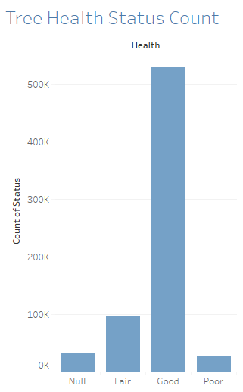
Tree Health Overview
Y-Axis indicates the Count of tree health status. X-Axis represents the condition as Null, Fair, Good and Poor
In an overview, 79.4% of trees were rated to be in Good condition, 14.5% were counted to be Fair, 4.2% as poor and the remaining 2.1% was counted as Null or dead trees
More than 500K Trees health have been recorded as Good. 30K as Null, 95K as Fair, and 25k as Poor
After some analysis, we see that Bronx has the highest recorded trees that are in Good condition followed by Queens and Staten Island
03

Slide 4
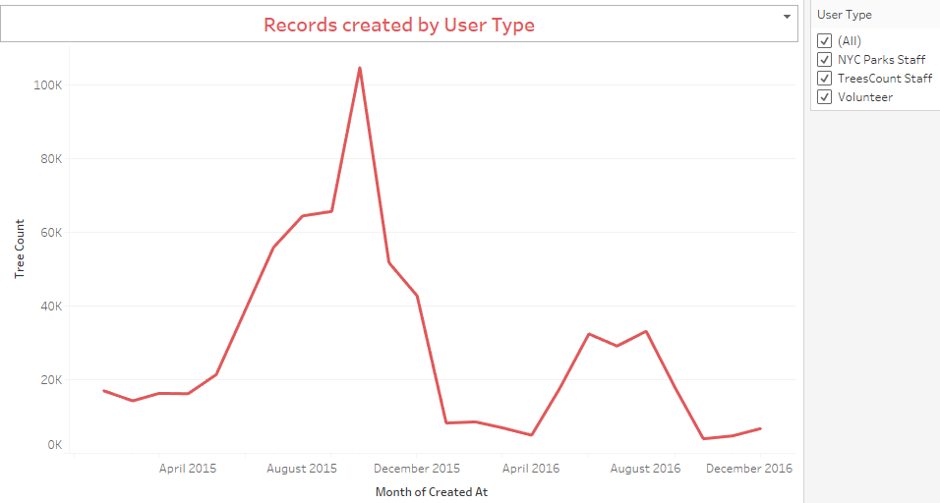
Records Created by User Type
Data collected by NYC Parks staff, Trees Count Staff and Volunteers
20K trees has been created by all the user types in April 2015
Highest count is 120K trees in the month of October 2015
Lowest count is 4K in April 2016 and October 2016
Sudden decrease in tree count was recorded in December 2015 and January 2016
Great increase in the trees count which were recorded in between the months of August and December 2015
04

Slide 5
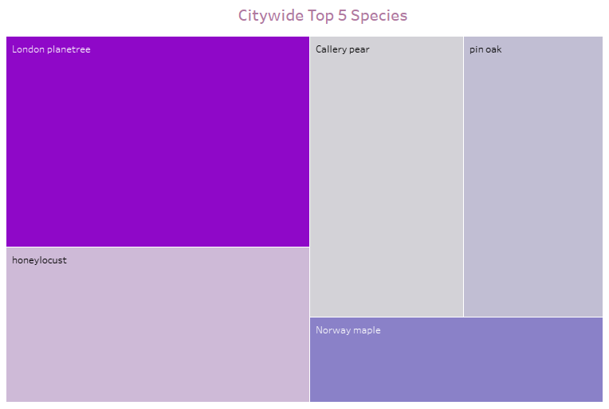
Citywide Top 5 Species
Almost 132 varieties of Species of the street trees across citywide
The Top 5 species include London Planetree, honey locust, Callery pear, Pin oak and Norway maple
The London Planetree species was the most prominent one during the years 1995 and 2005 census as well
05

Slide 6
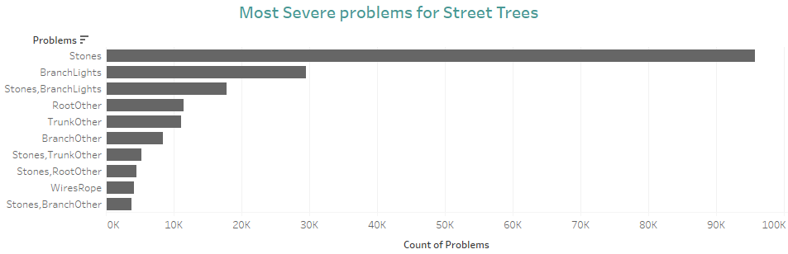
Most Severe Problems for Street Trees
Trees have problems like Stones, BranchLights, Roots, Trunks, WiresRope etc., which are creating Growth issues and Health conditions
X-Axis represents the Count of Problems affected by each problems that are represented on the Y-Axis
As we can see, that the Stones are creating the highest amount of problem to almost 95.5K trees count whereas the lowest recorded problem is Stones, BranchOther for almost 3.5K trees count
06

Slide 7
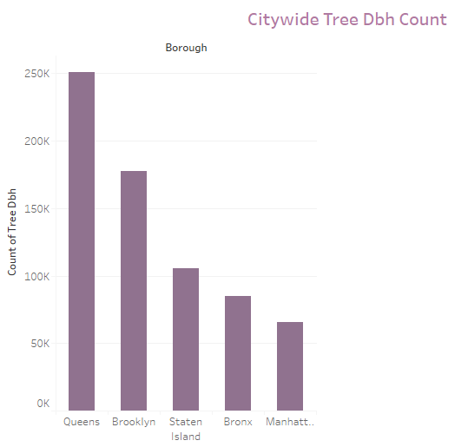
Citywide Tree DBH Count
DBH (Diameter at breast height) is a standard method of measuring the size of a Tree.
In the USA, this measurement is taken at 4.5 feet above the ground level
According to the latest NYC 2015 Street Trees Count report, there are almost 683,788 trees in the NYC
Y-axis represents the count of Tree DBH ranging from 0K – 250K whereas, the X-axis represents 5 boroughs
Queens has more trees than any other borough, almost 0.25 Million count of tree DBH has been recorded
Manhattan has the lowest count of tree DBH almost equivalent to 65K
07

Slide 8
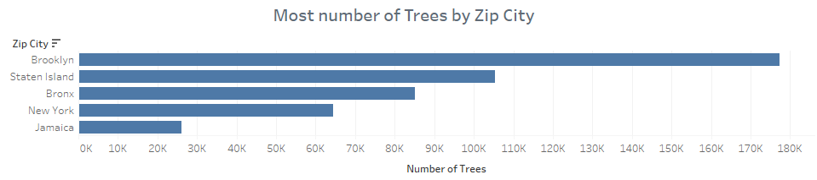
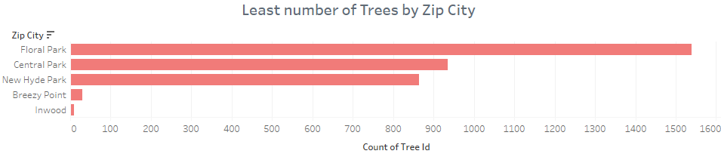
Most vs Least Number of Trees by Zip City
X-axis has the number of trees count ranging from 0K to 180K
Brooklyn has the highest number of trees of almost 178K, Staten Island has recorded 105K trees, Bronx has about 85K tree count, followed by New York which has 64K trees and finally Jamaica with 25K
X-Axis has Count of Tree ID ranging from 0 – 1600
Inwood has the lowest count of trees which is about 10, followed by Breezy Point which has almost 30 trees, New Hyde Park has 860, Central Park has 930 and lastly Floral Park has about 1535 tree count
08

Slide 9

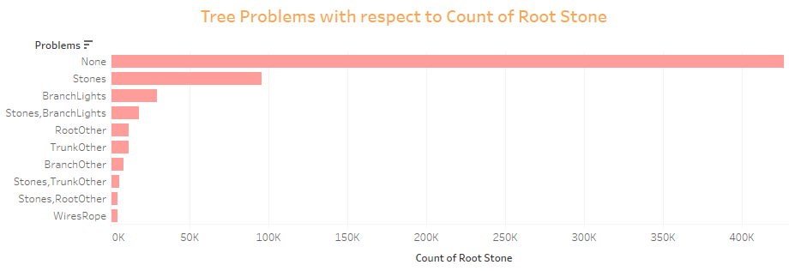
Tree Problems due to Root Stone
Trees have problems due to Root Stone which will make Tree core weak and causes several issues
X-Axis represents the Count of Root Stone affected by each problems that are represented on the Y-Axis
As we can see, that the Stones are creating the highest amount of problem to almost 96K trees count whereas the lowest recorded problem is WiresRope for almost 5K trees count
09

Slide 10
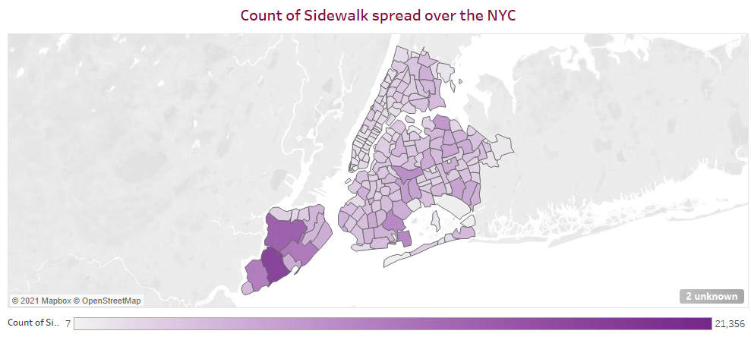
Count of Sidewalk spread over the NYC
As we can see, that the Sidewalk spread over the NYC
Plotted using Maps with real-time data and visualized with a range varying from 7 to 21,356
We have used Zip Codes to showcase the amount of spread in the city.
10
Notes:
3 crop season ends we invest 1.5 crores in different

Slide 11
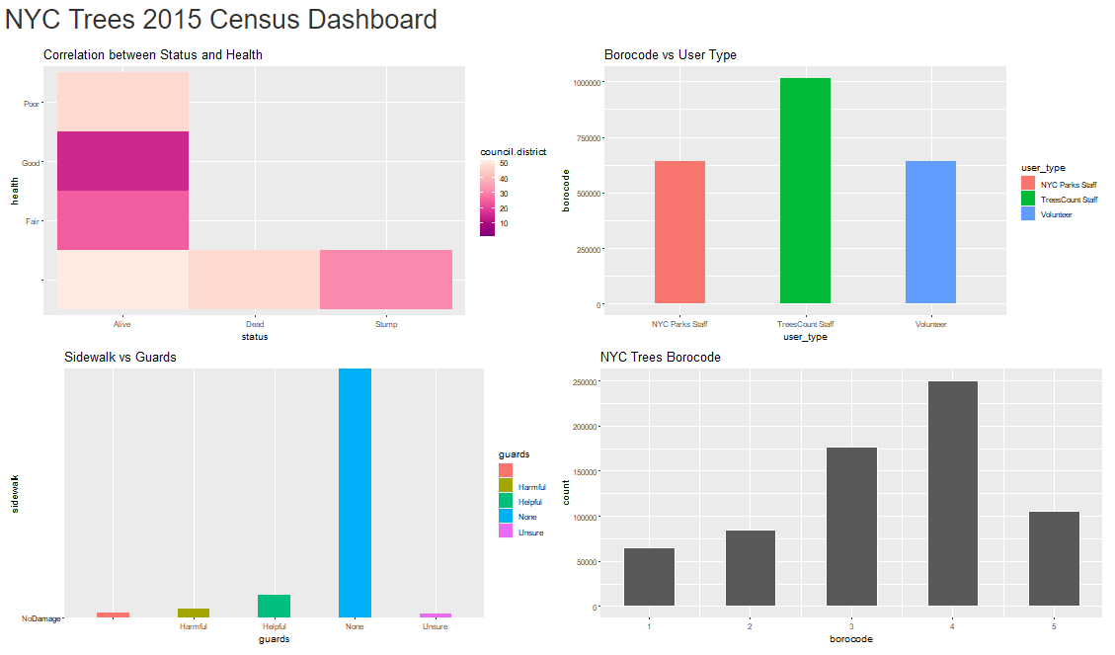
R Shiny Dashboard
11
Notes:
3 crop season ends we invest 1.5 crores in different

Slide 12
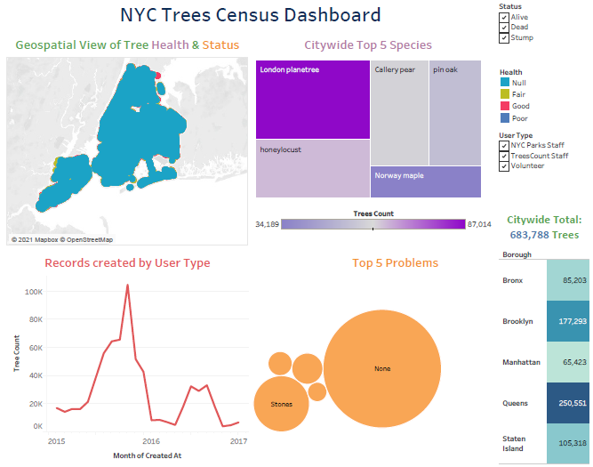
Tableau Dashboard 1
12
Notes:
3 crop season ends we invest 1.5 crores in different

Slide 13
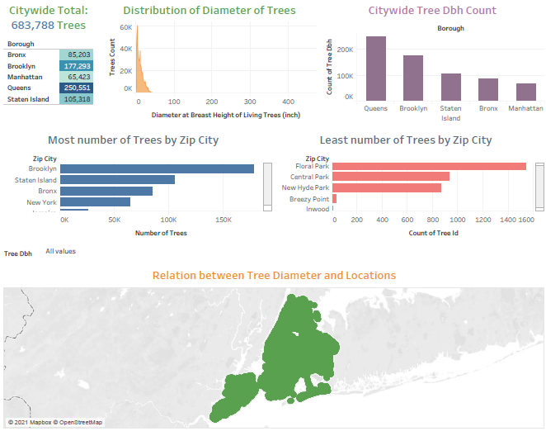
Tableau Dashboard 2
13
Notes:
3 crop season ends we invest 1.5 crores in different

Slide 14
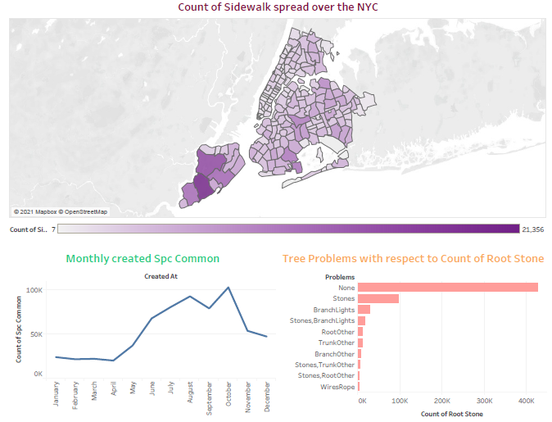
Tableau Dashboard 3
14
Notes:
3 crop season ends we invest 1.5 crores in different

Slide 15
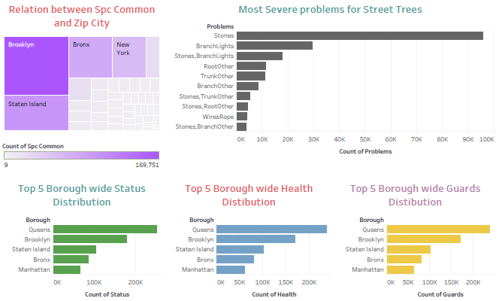
Tableau Dashboard 4
15
Notes:
3 crop season ends we invest 1.5 crores in different

Slide 16
Conclusion
Increase the Water and Pesticides resources for Saplings and small plants
Utmost care needs to be taken for Manhattan and provide with right staff for improvements
Health checkup and proper care should be implemented
NYC must allocate necessary funds and raise money from the NGO’s, Volunteers, and Organizations
The City representatives must take precautions by implementing proper policies and procedures
Increase the number of Green Initiative Campaigns throughout the city
Remove unwanted trees and support for continuous maintenance
16
Notes:
3 crop season ends we invest 1.5 crores in different

